Slide 1
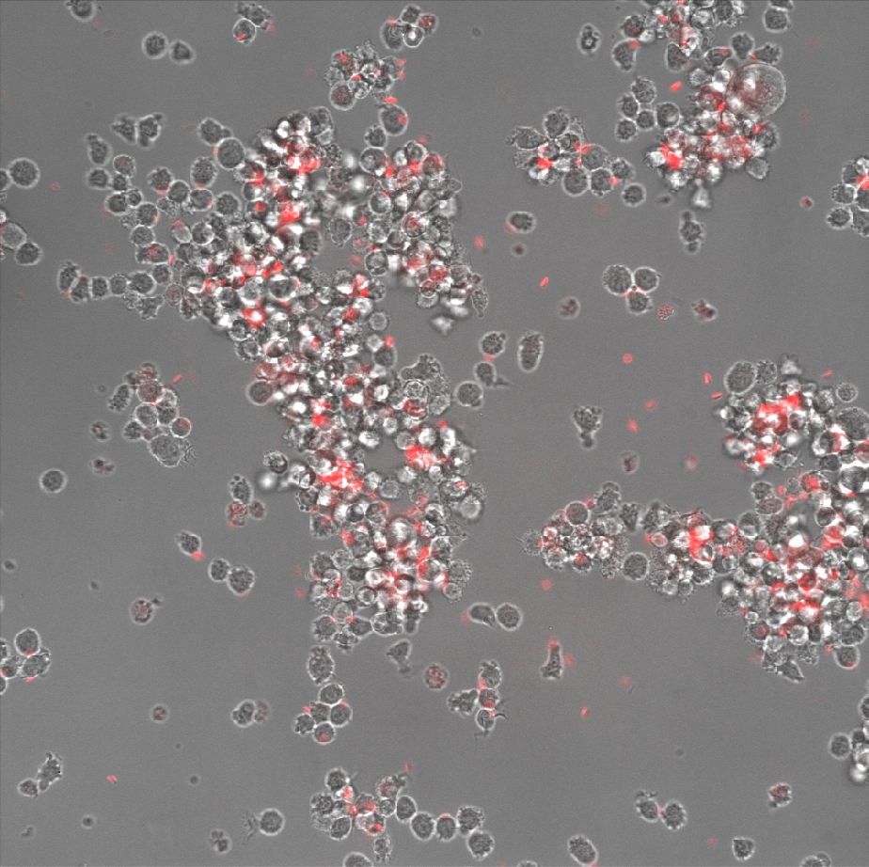
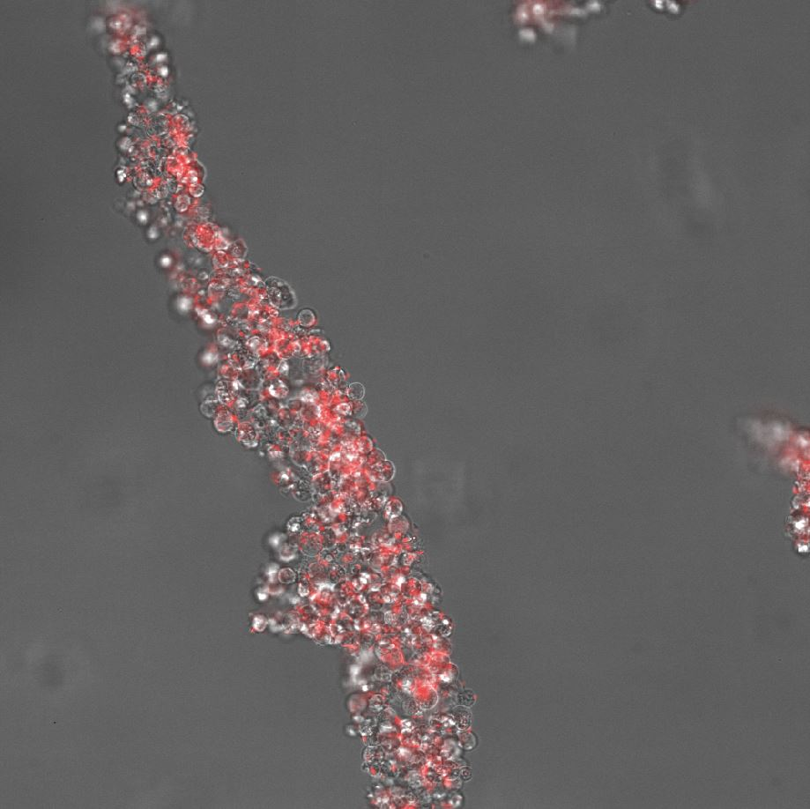
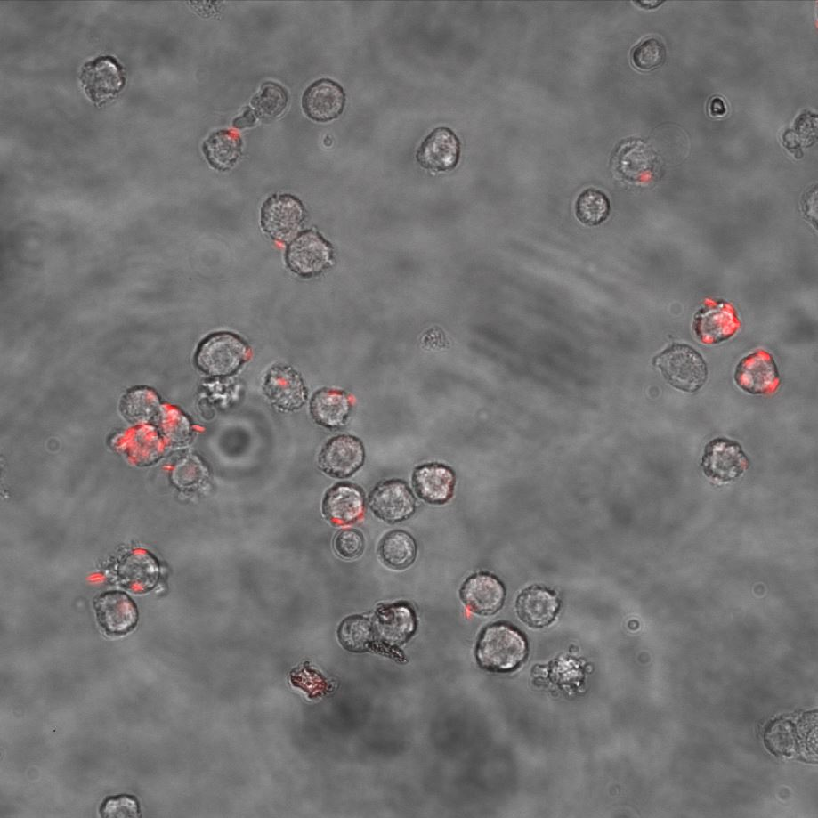
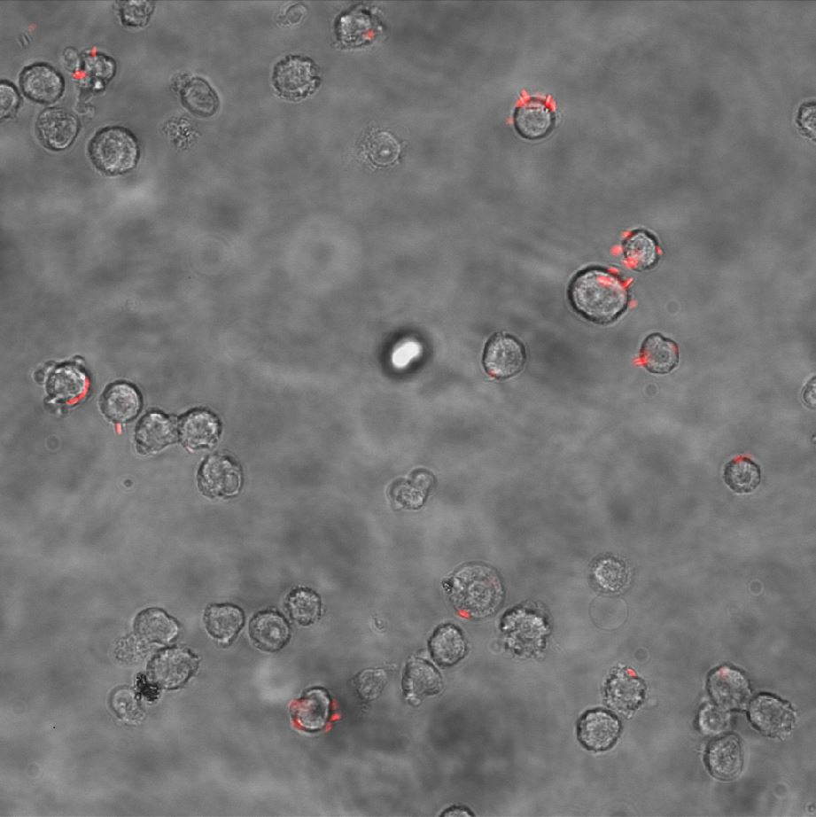
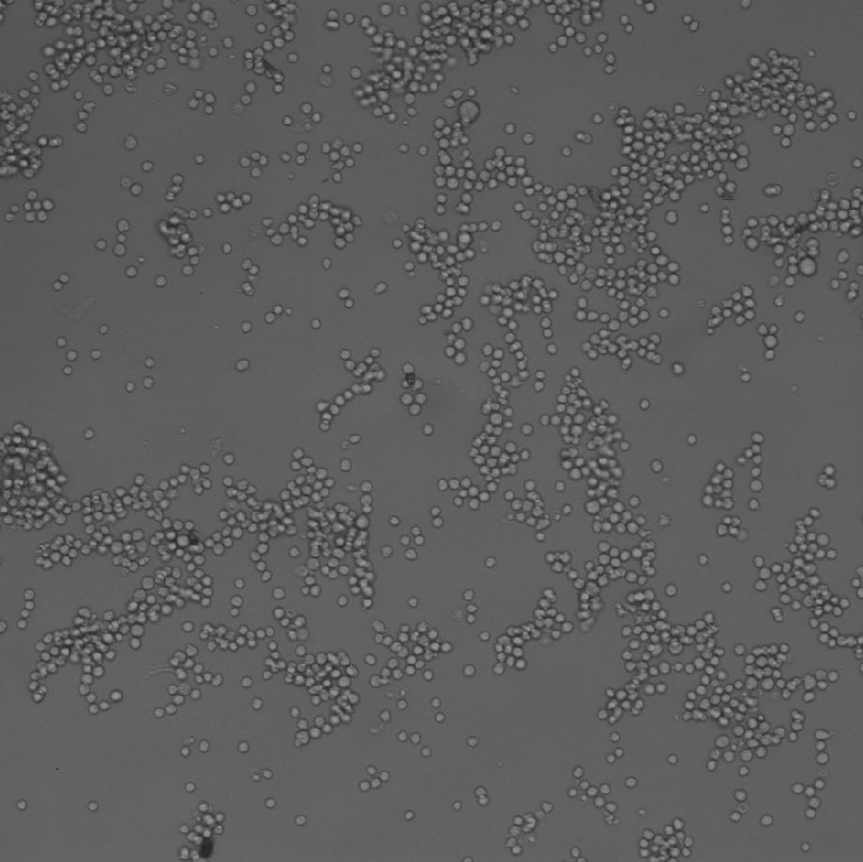
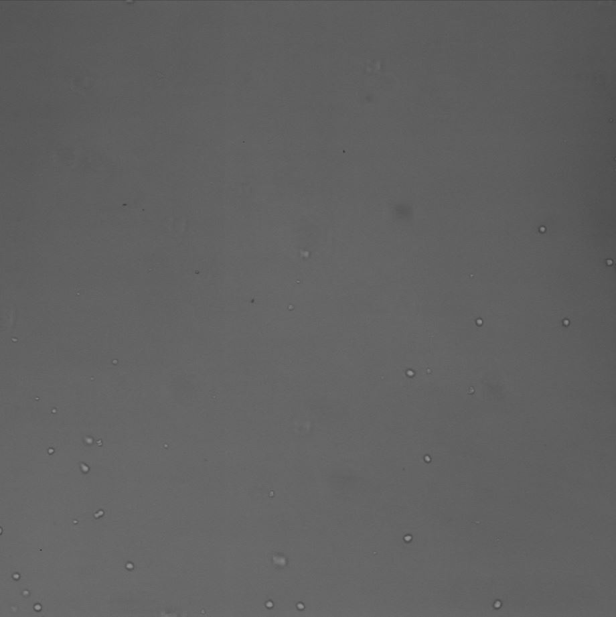
20 ×
50 µm
50 µm
40 ×
20 µm
20 µm
50 µm
Well 1
Well 2
10 ×
100 µm
100 µm
50 µm

Slide 2
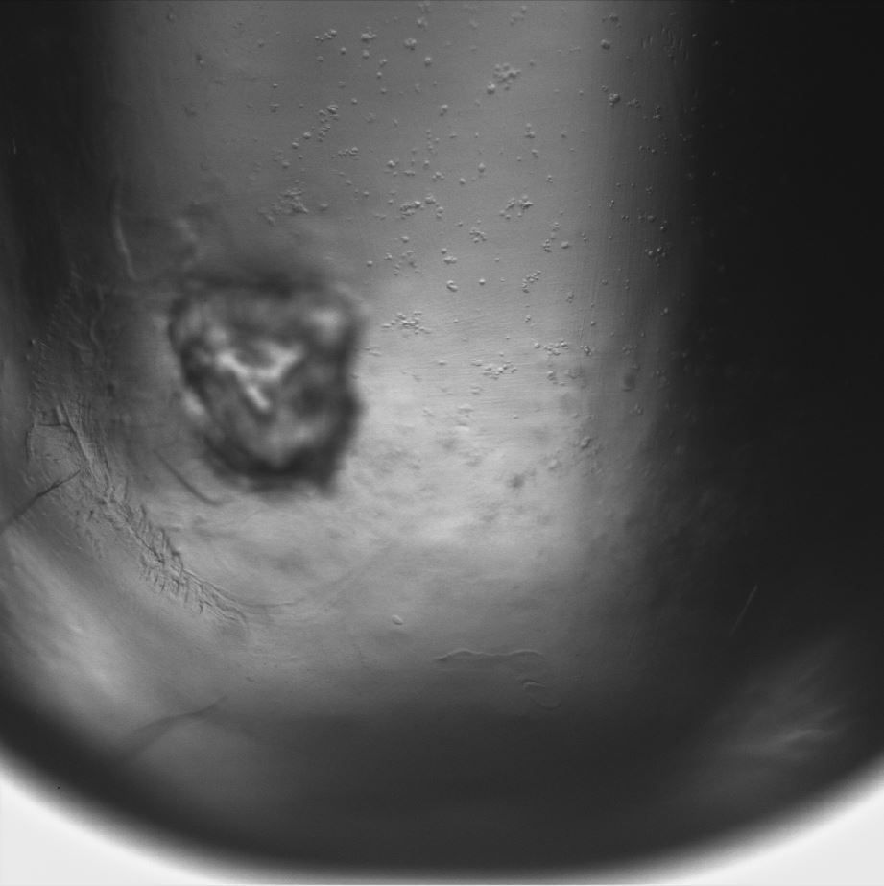
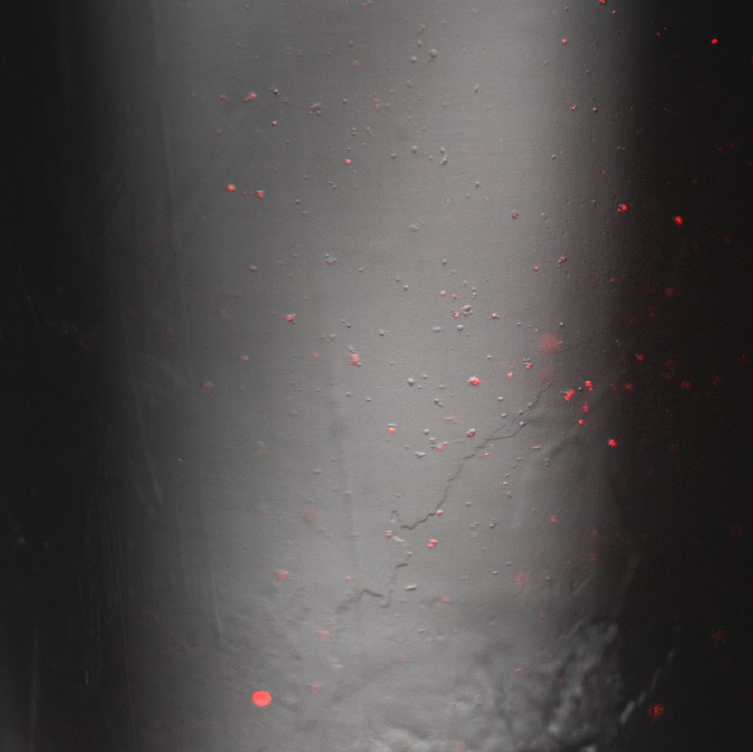
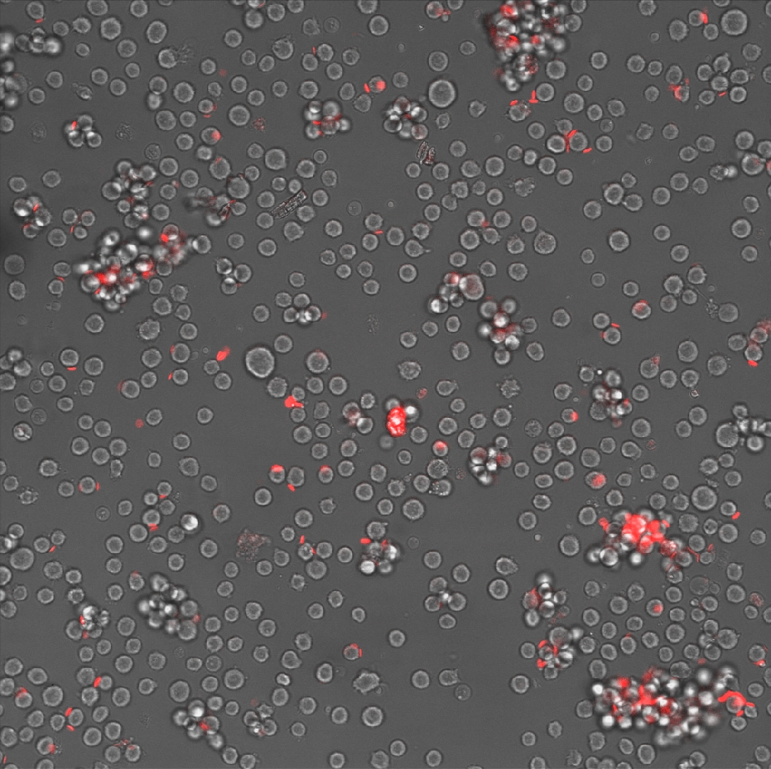
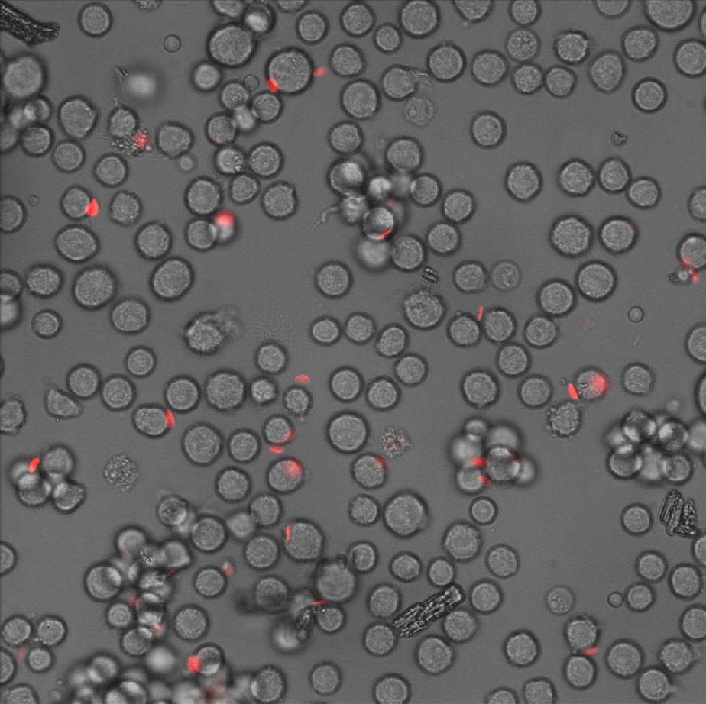
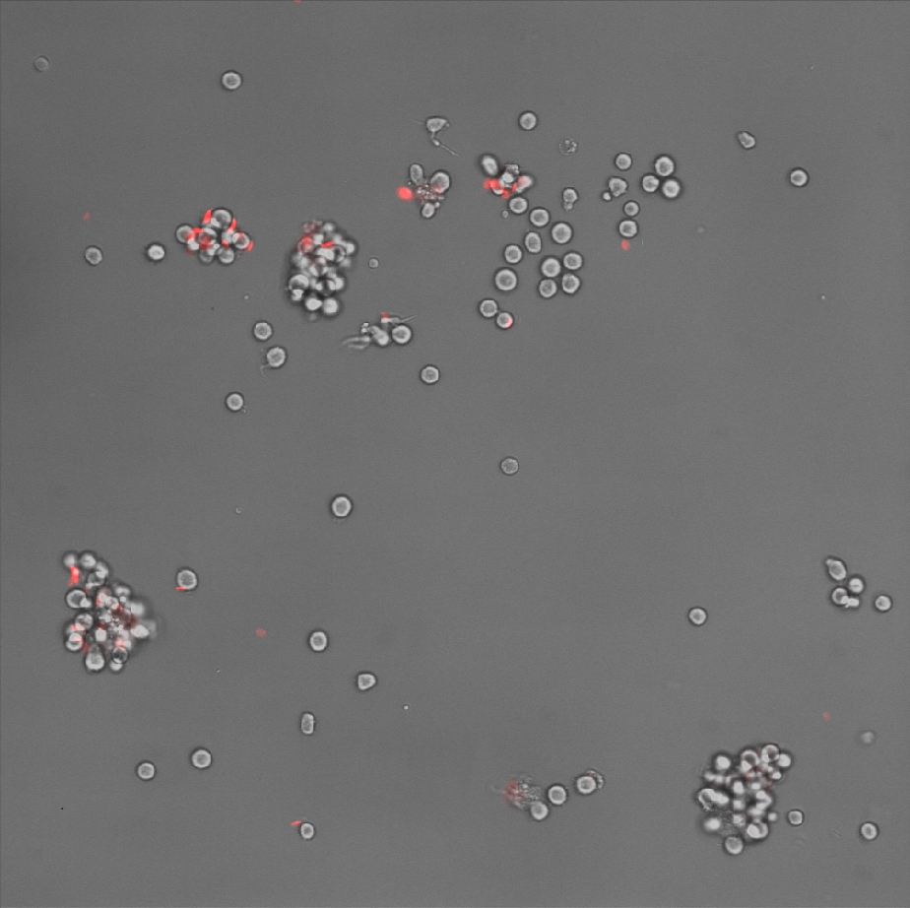
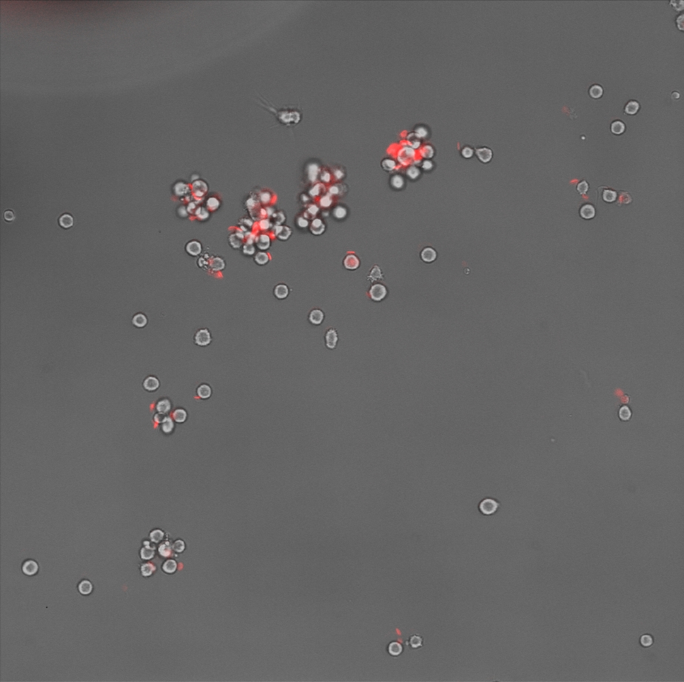
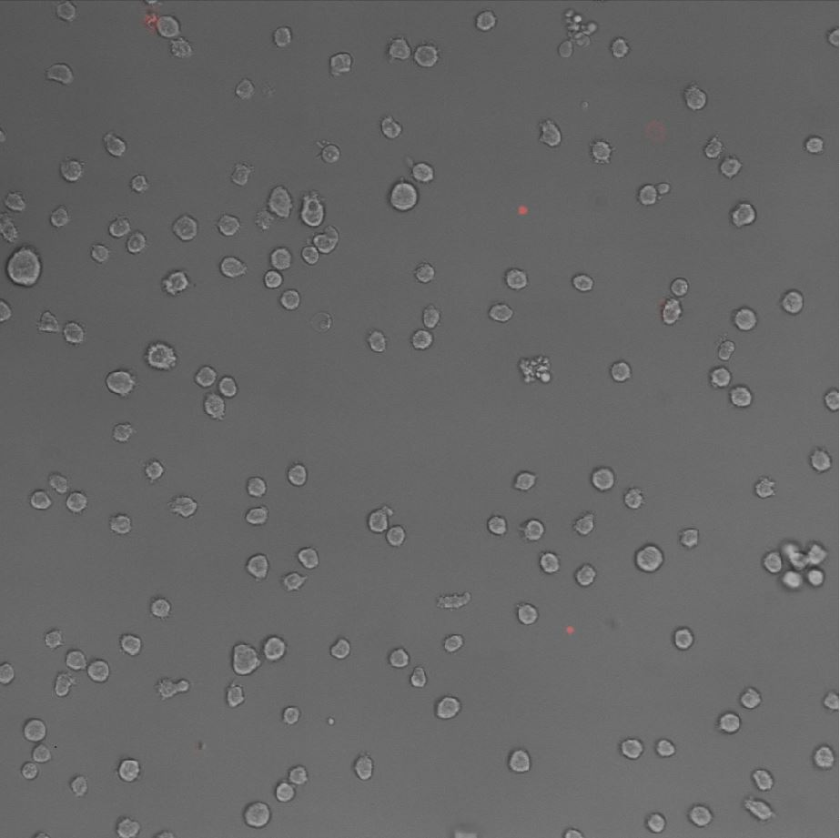
4 ×
200 µm
200 µm
20× 40×
50 µm
20 µm
20×
20×
20×
50 µm
50 µm
50 µm
50 µm

Slide 3
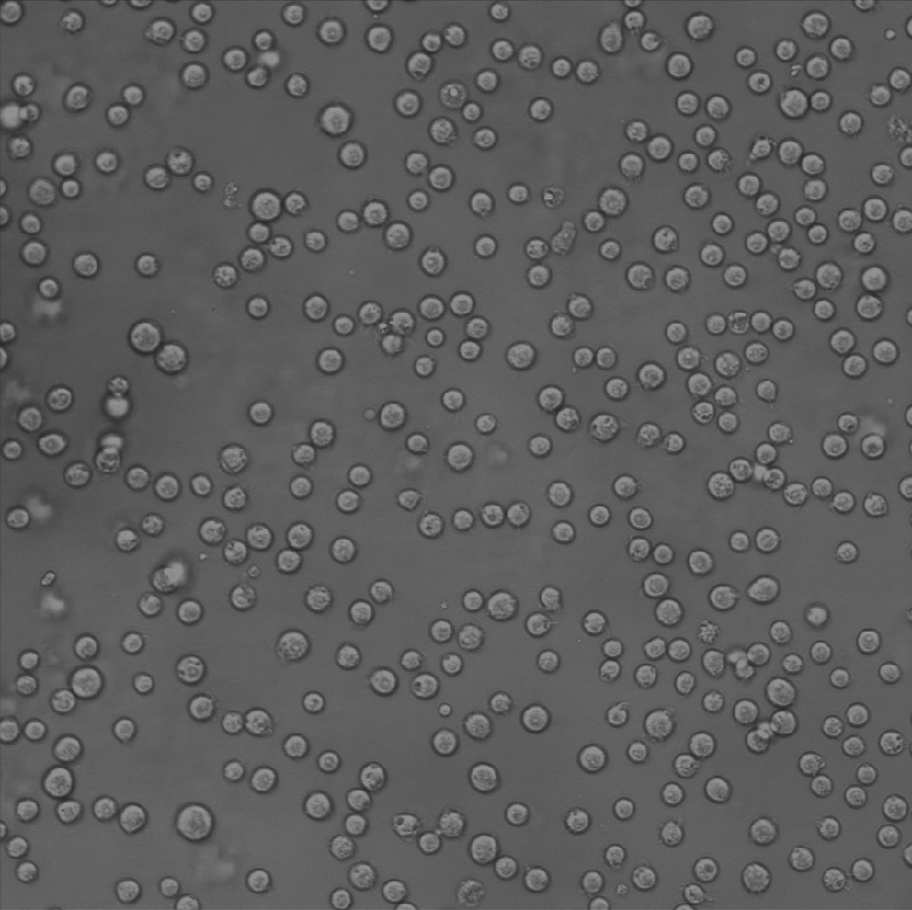
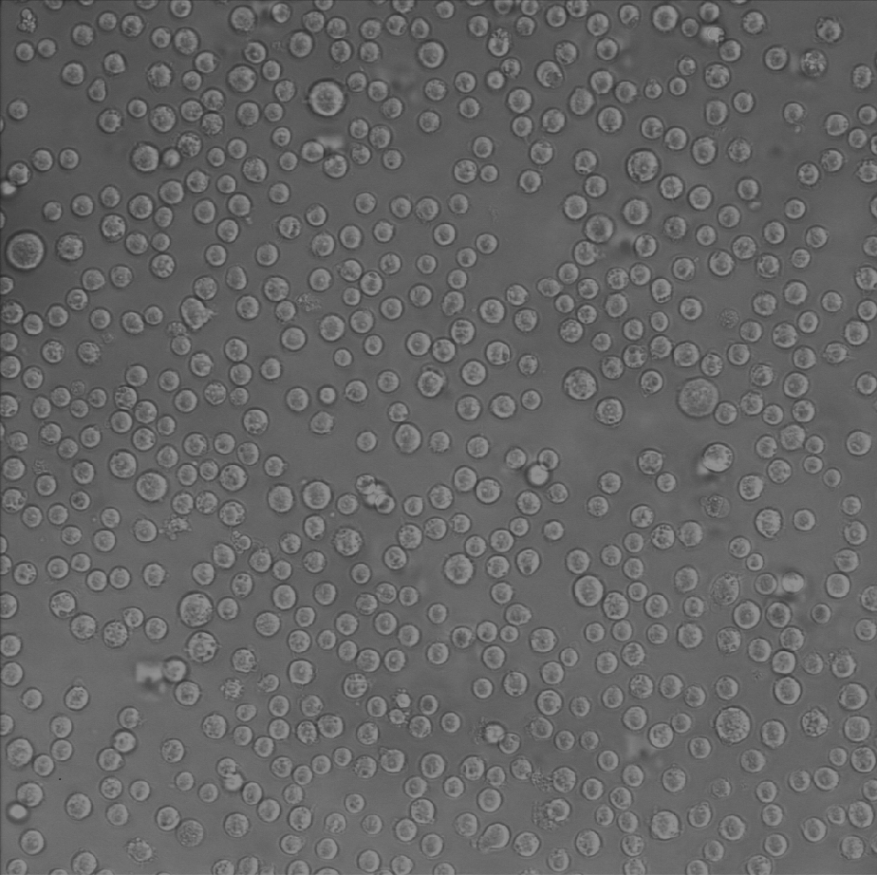
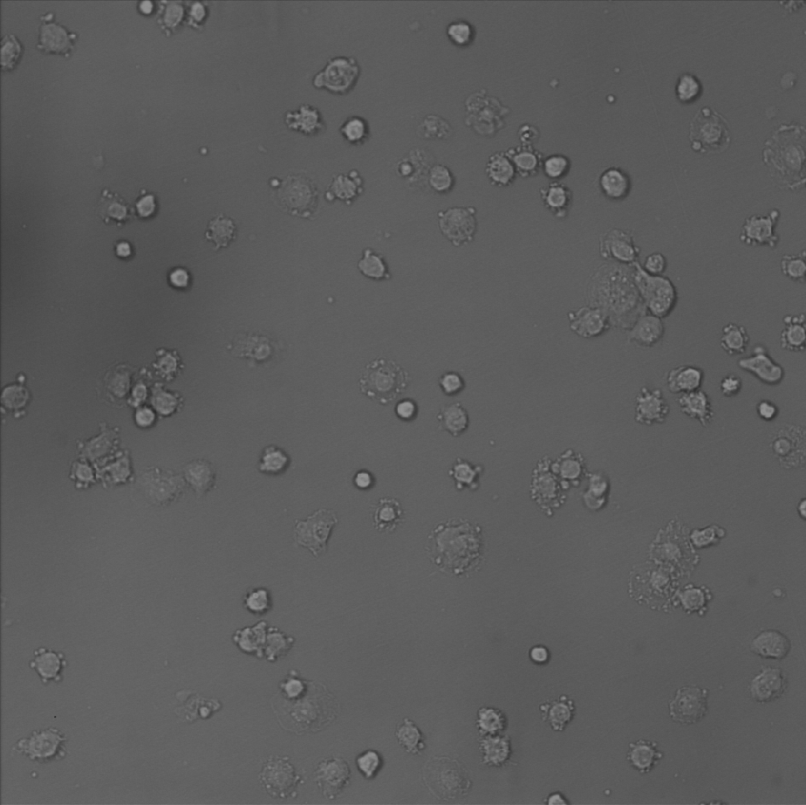
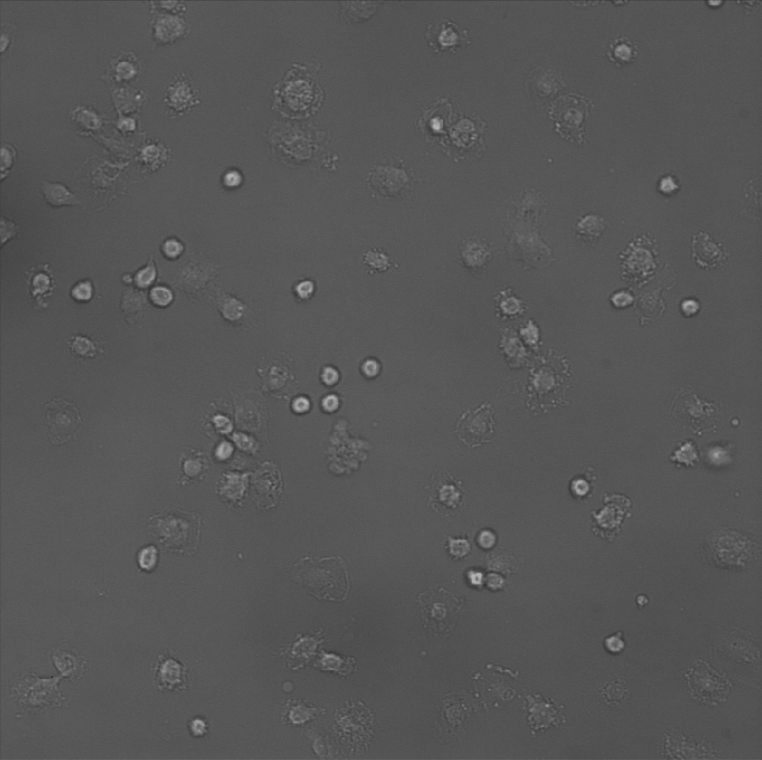
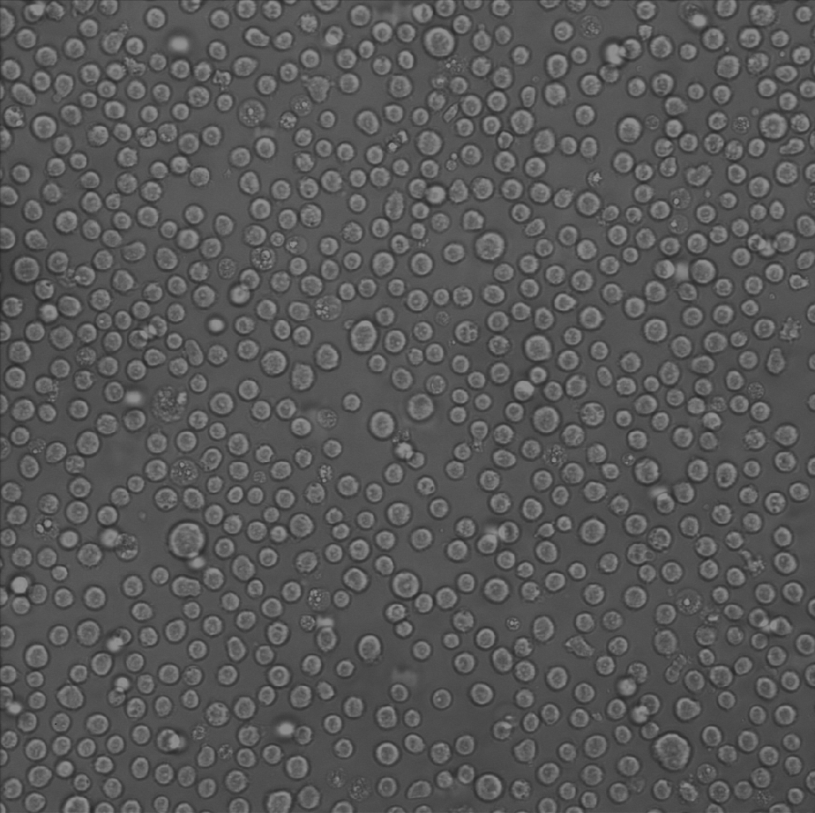
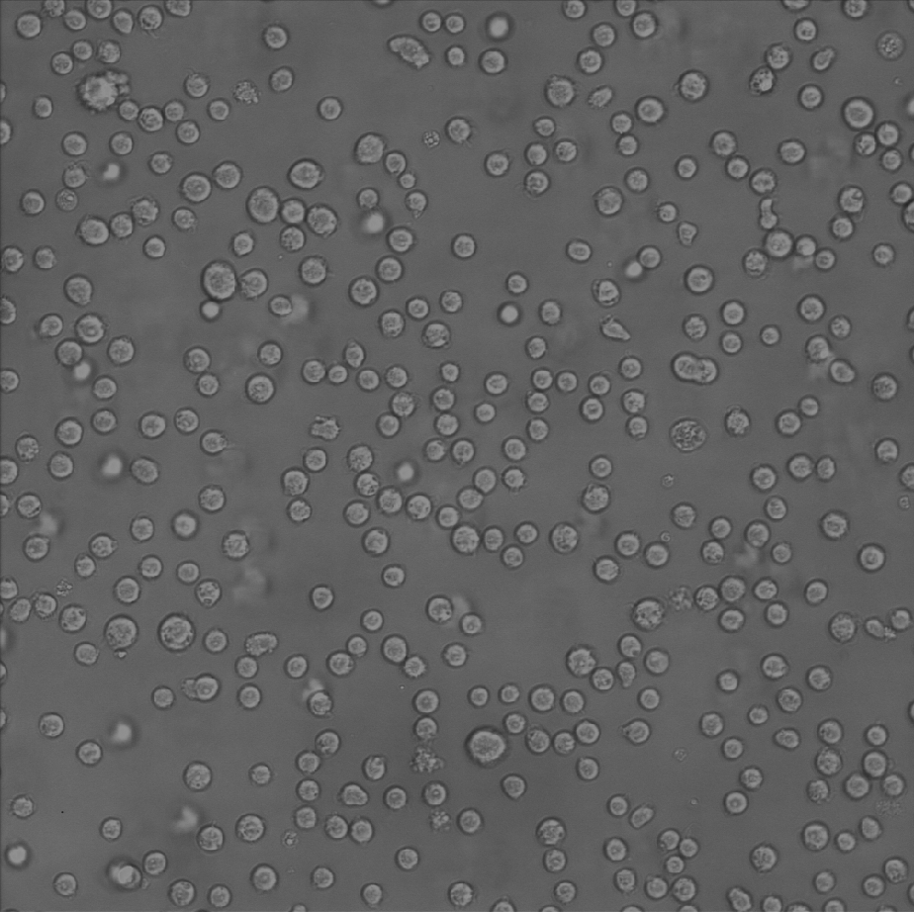
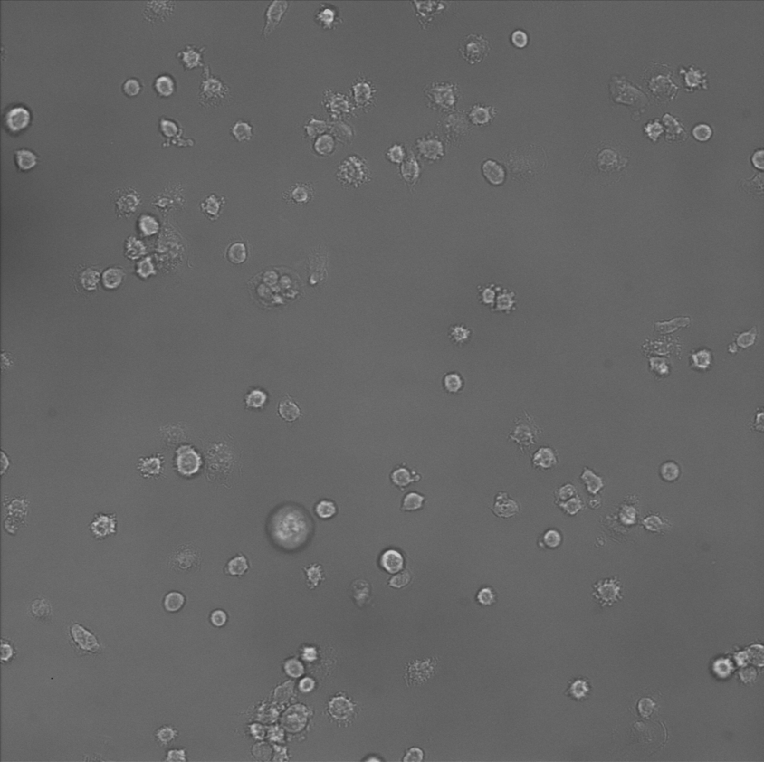
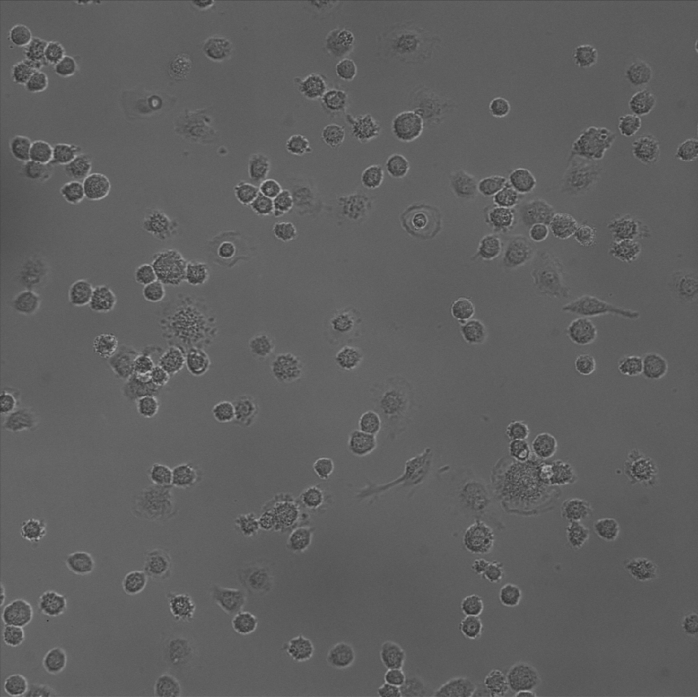
THP-1 PMA differentiation 2018.5.07
1
2
1
2
50 µm
50 µm
50 µm
50 µm
3
4
3
4
50 µm
50 µm
50 µm
50 µm
0 h
24 h

Slide 4
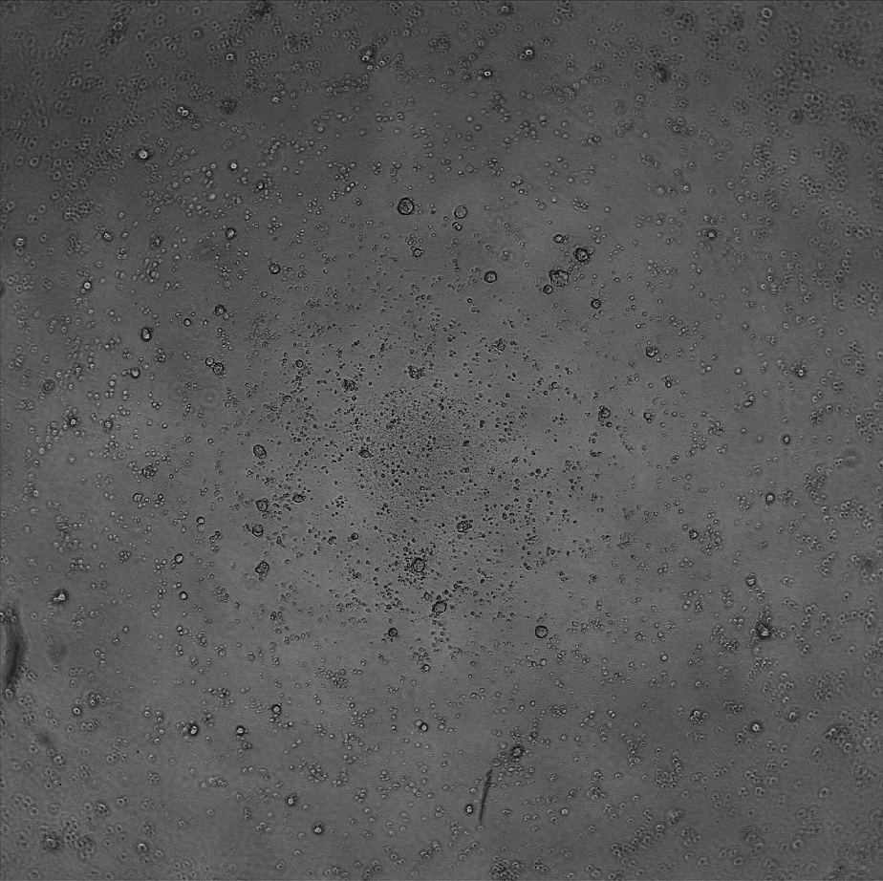
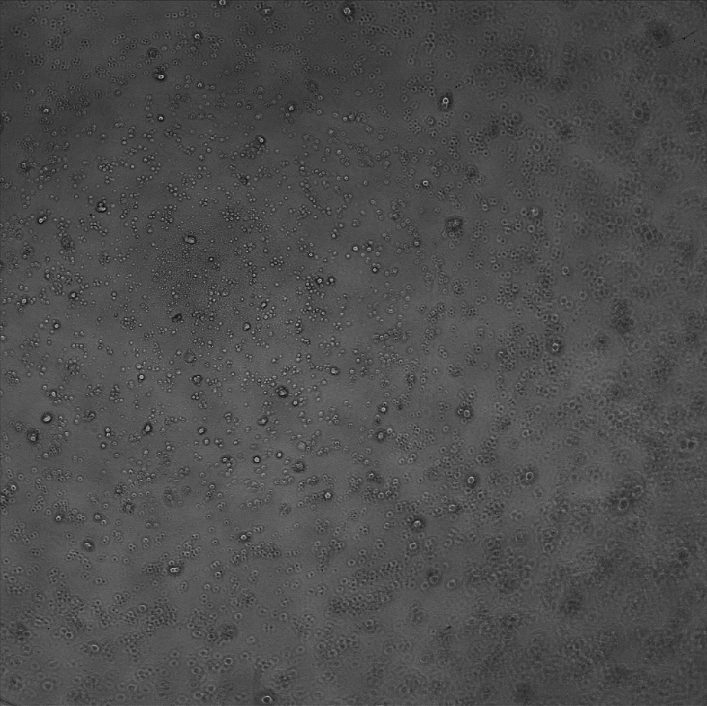
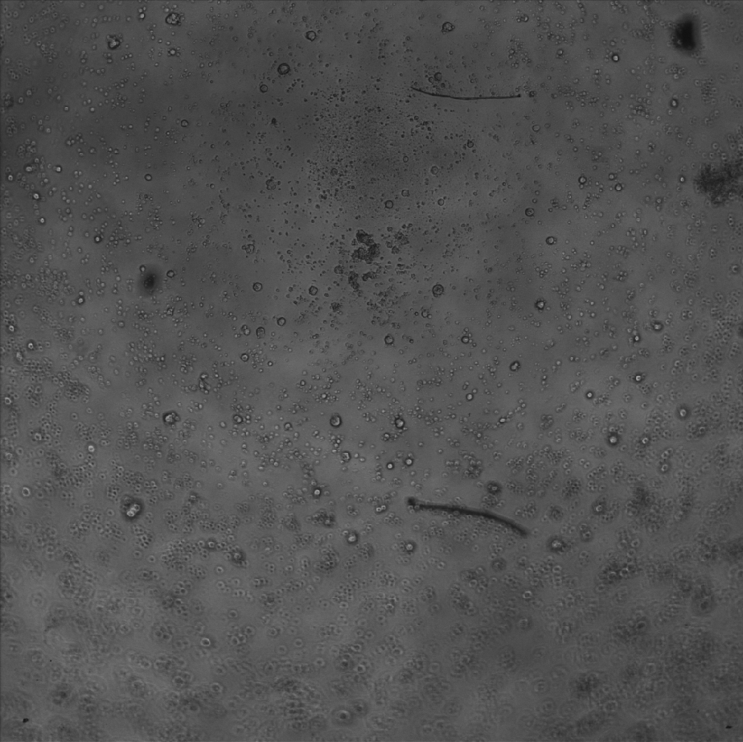
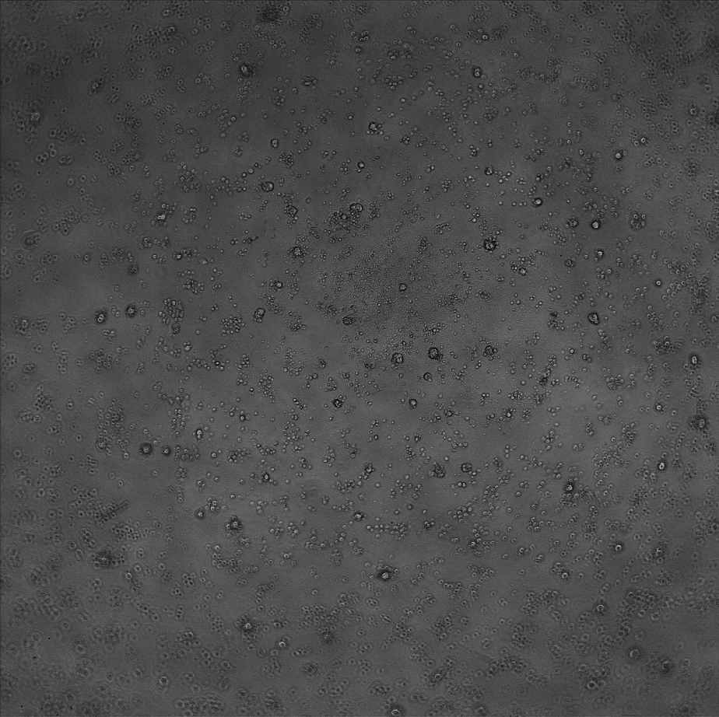
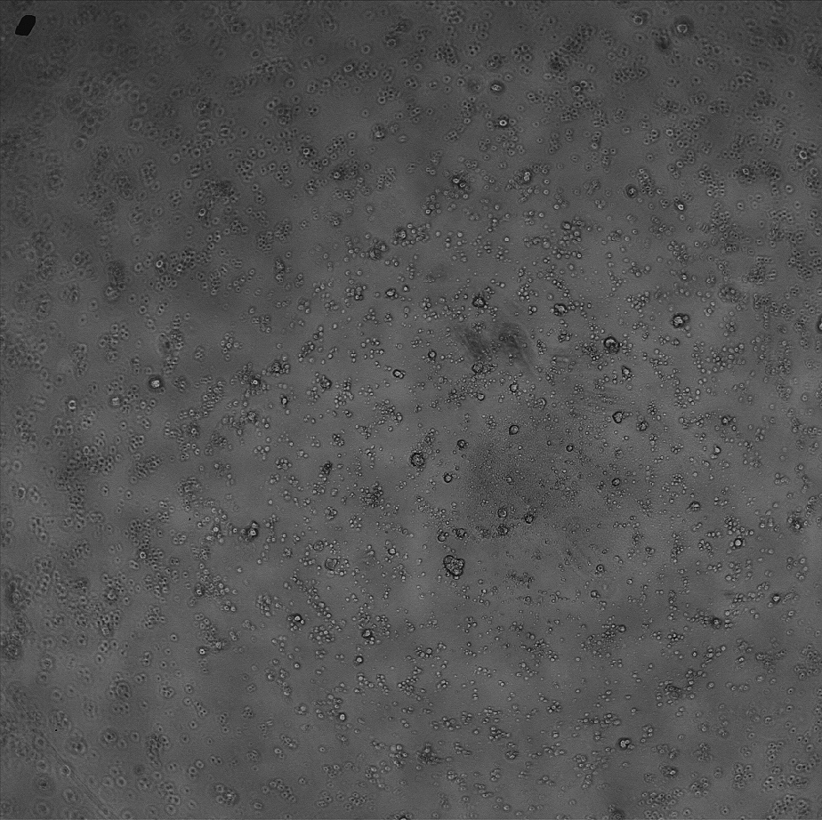
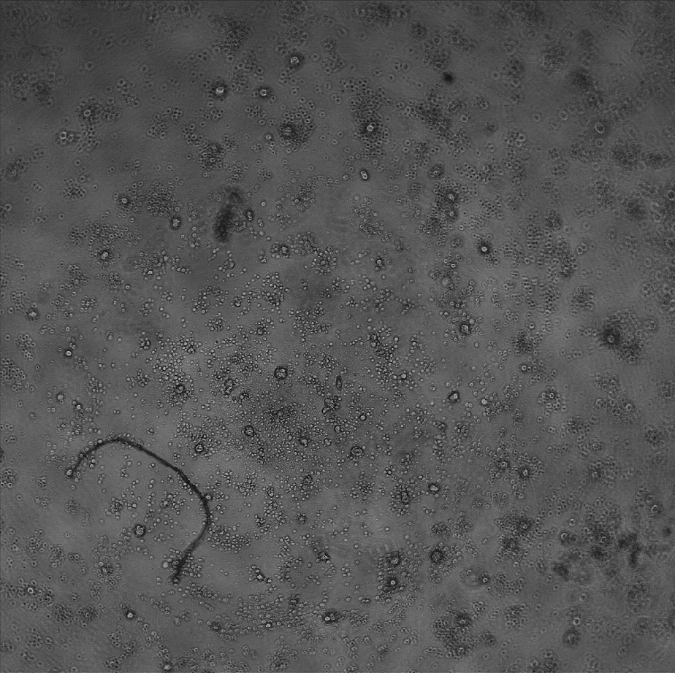
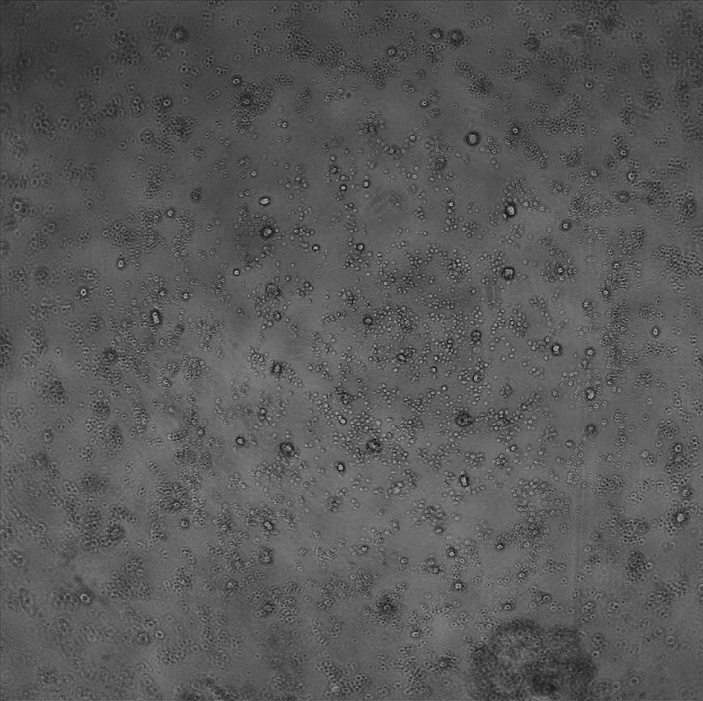
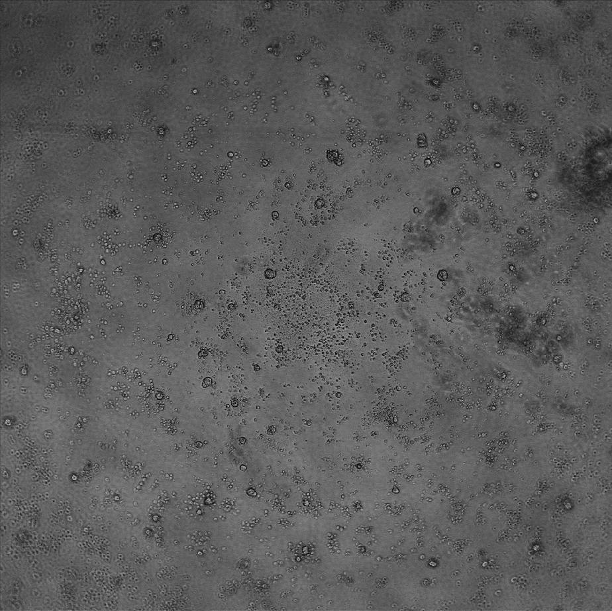
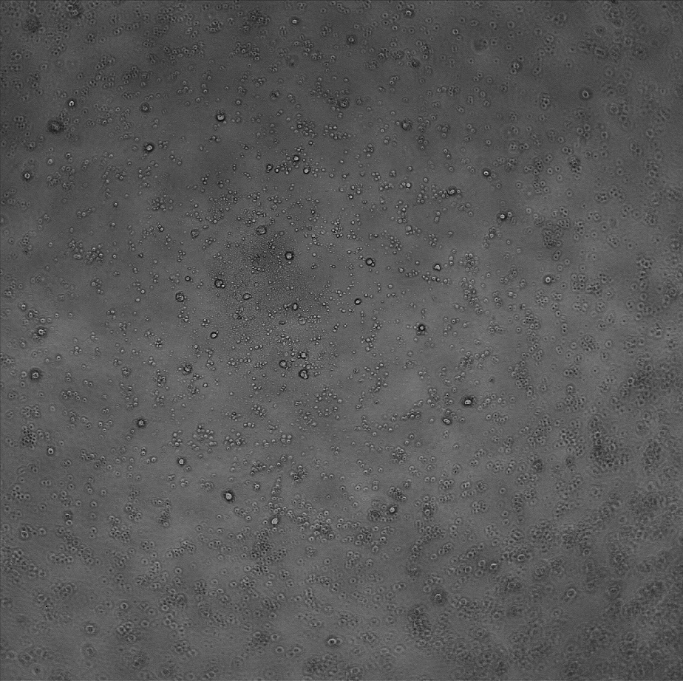
iPSC 2018.5.07
Control 92 hours after seeding
1
2
3
200 µm
200 µm
200 µm
4
5
6
200 µm
200 µm
200 µm
7
8
9
200 µm
200 µm
200 µm

Slide 5
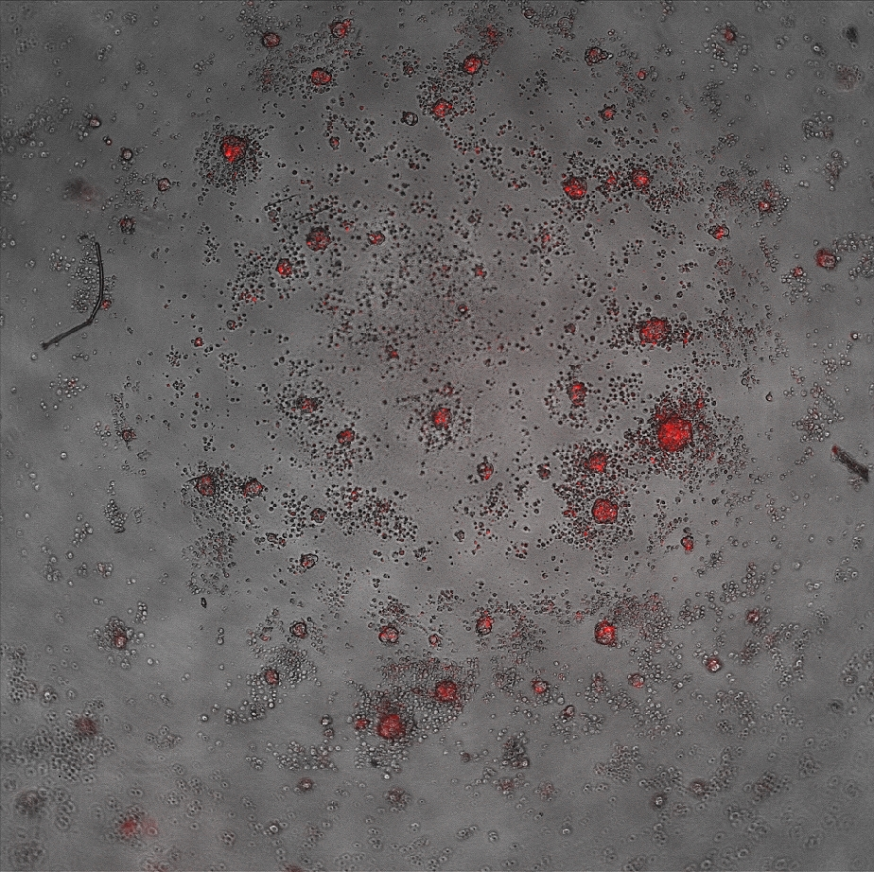
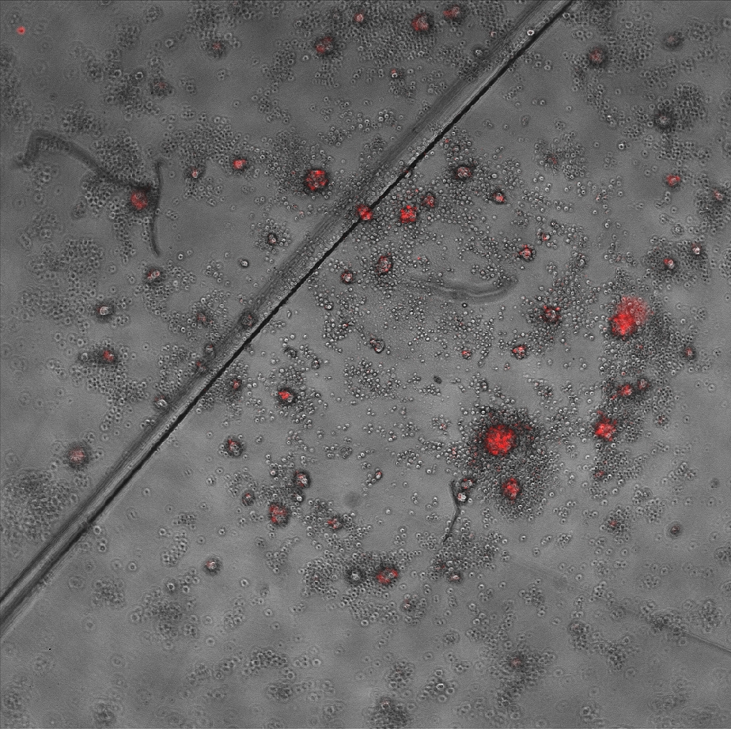
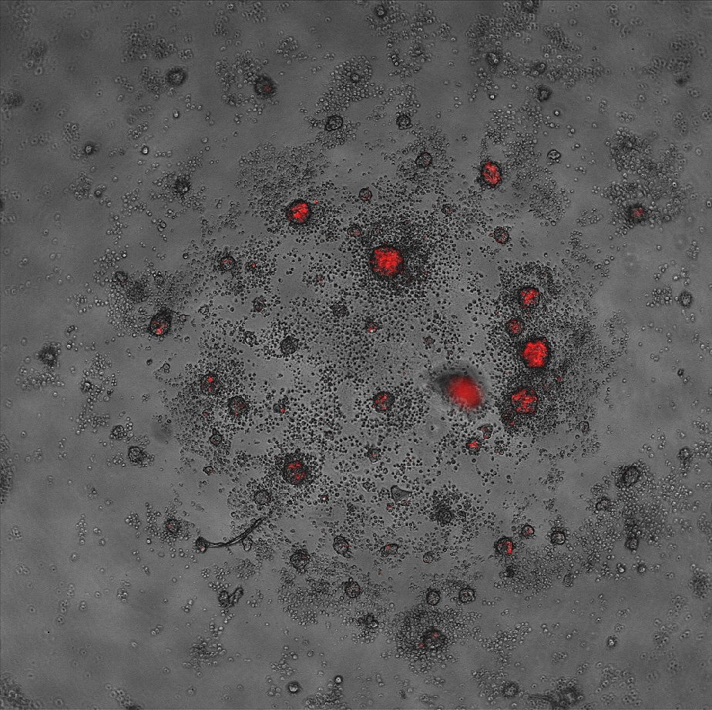
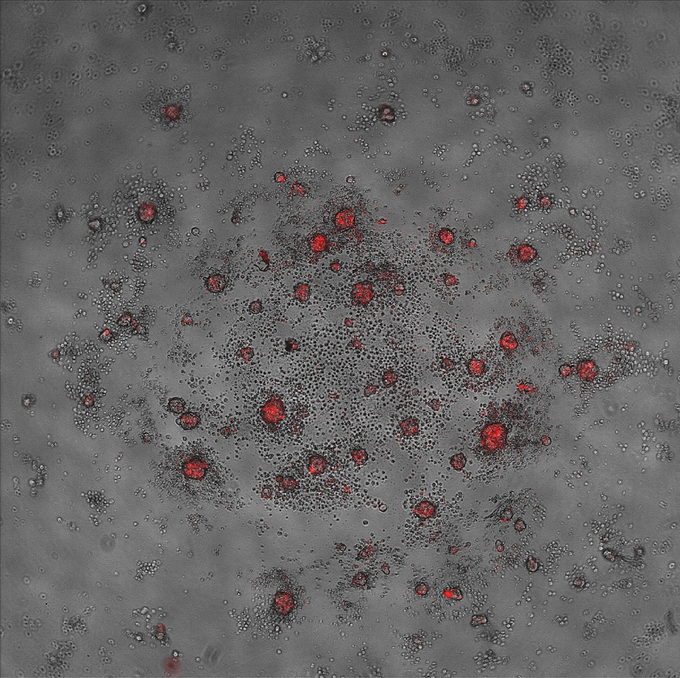
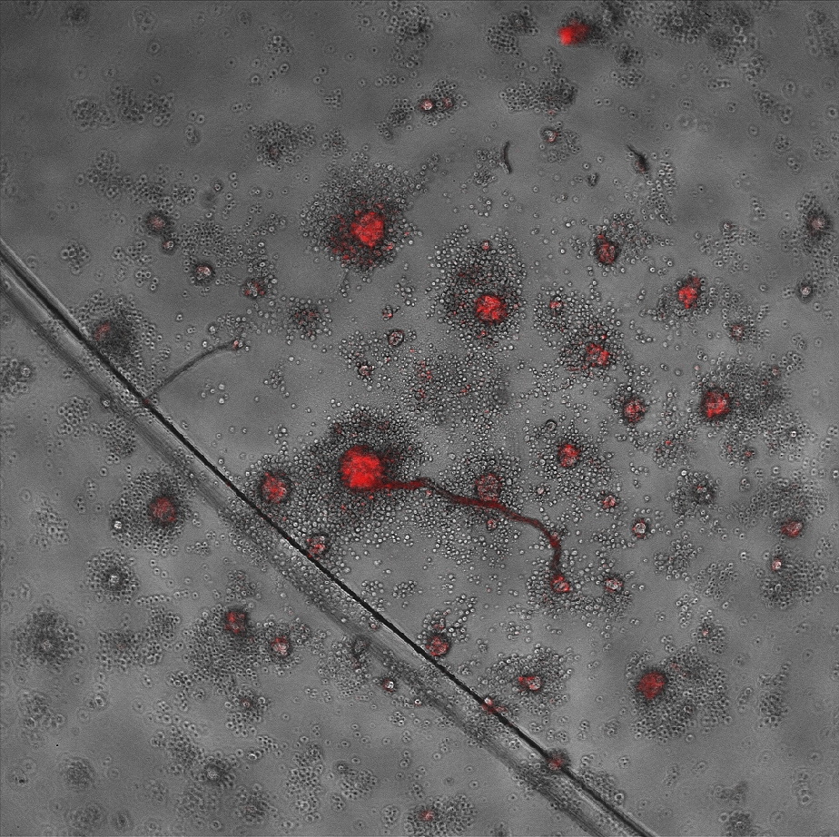
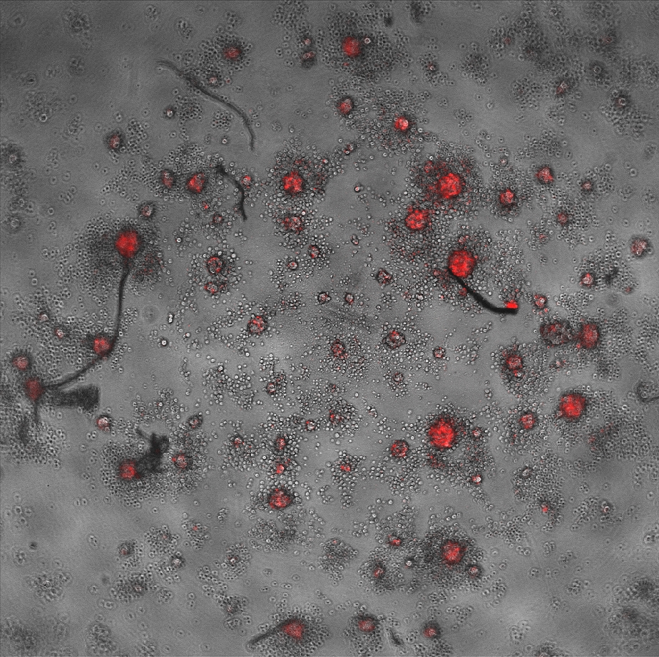
iPSC 2018.5.07
Cell/particle 90 hours after seeding
1
2
3
200 µm
200 µm
200 µm
4
5
6
200 µm
200 µm
200 µm

Slide 6
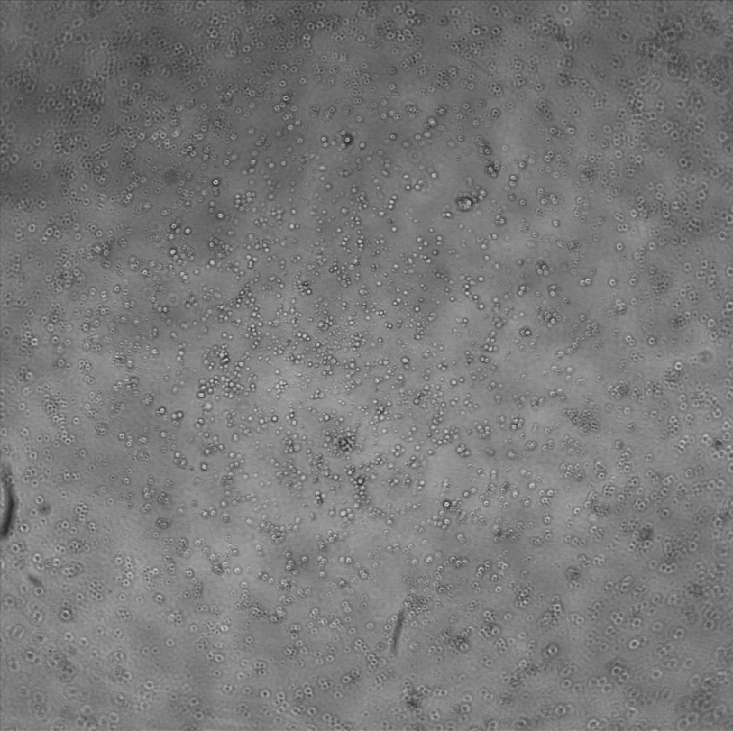
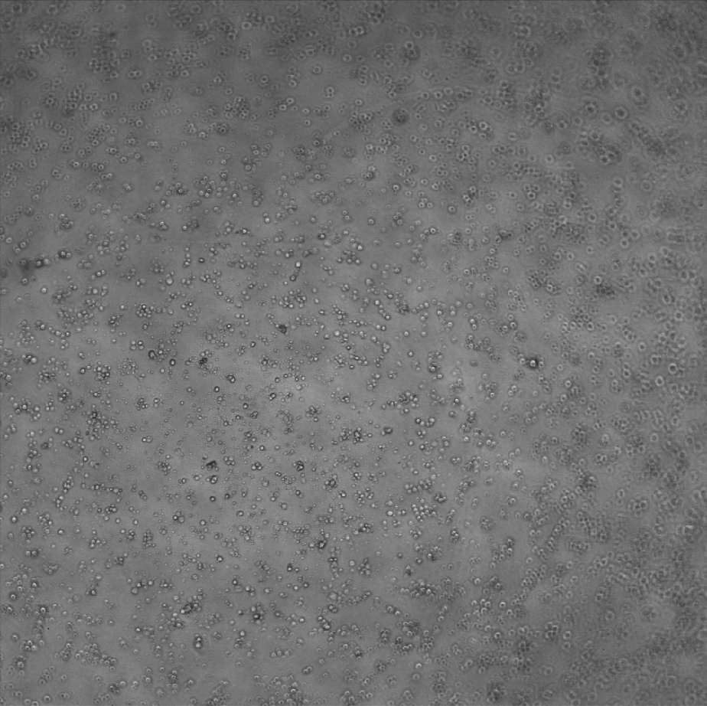
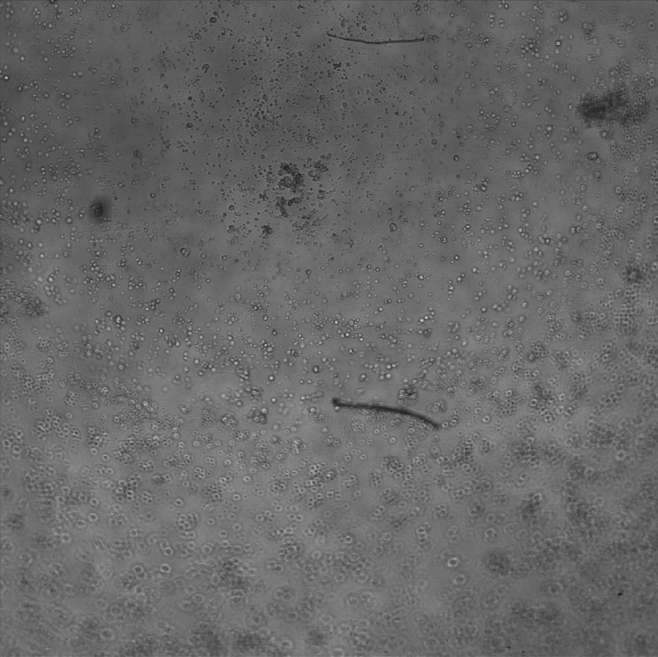
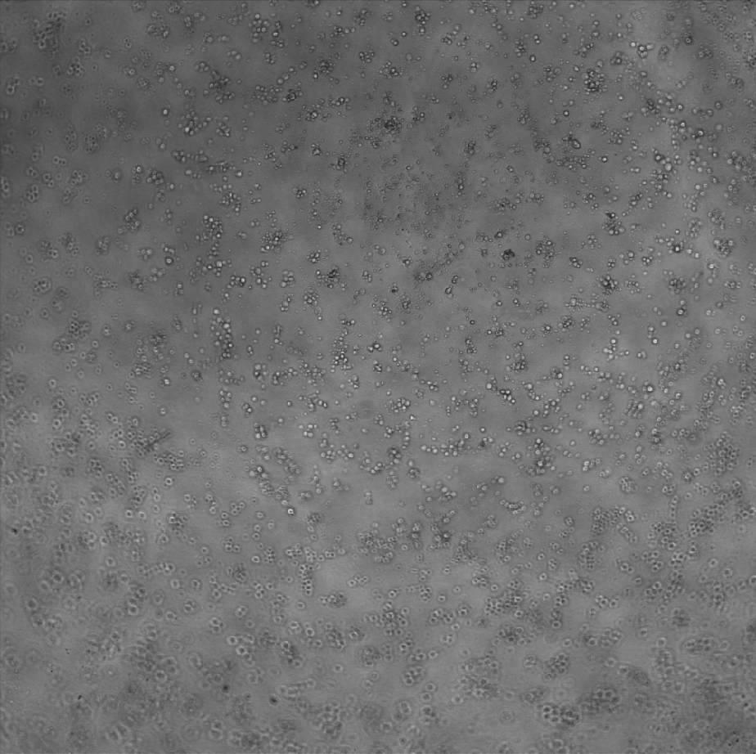
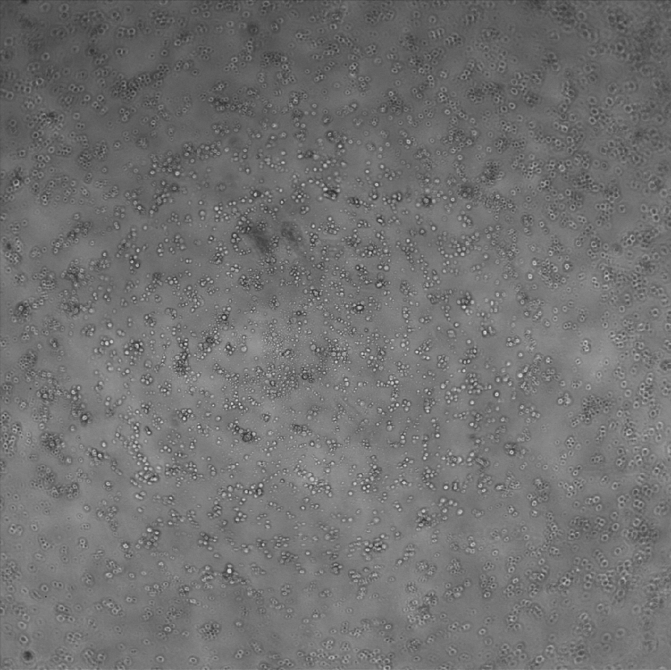
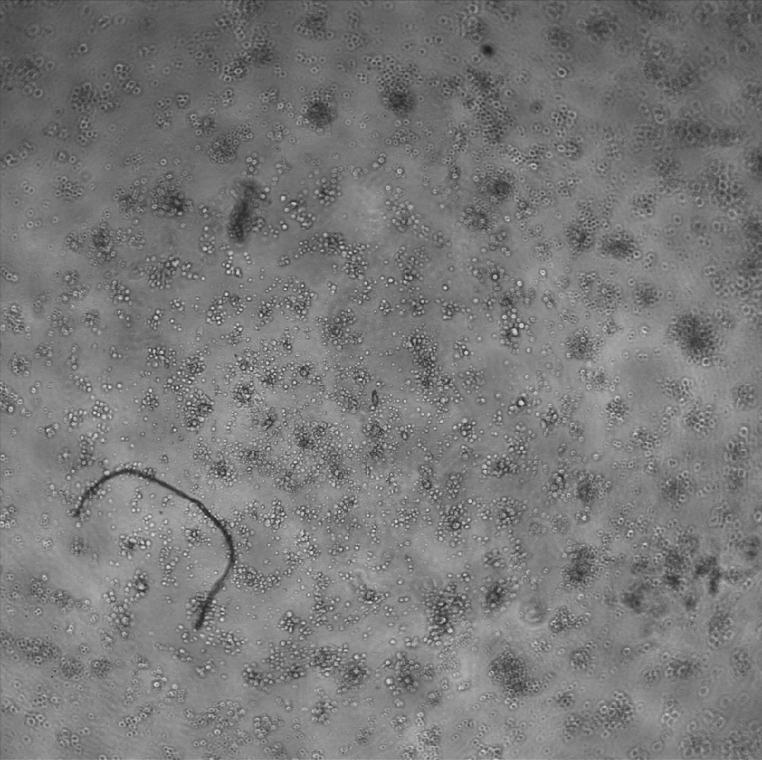
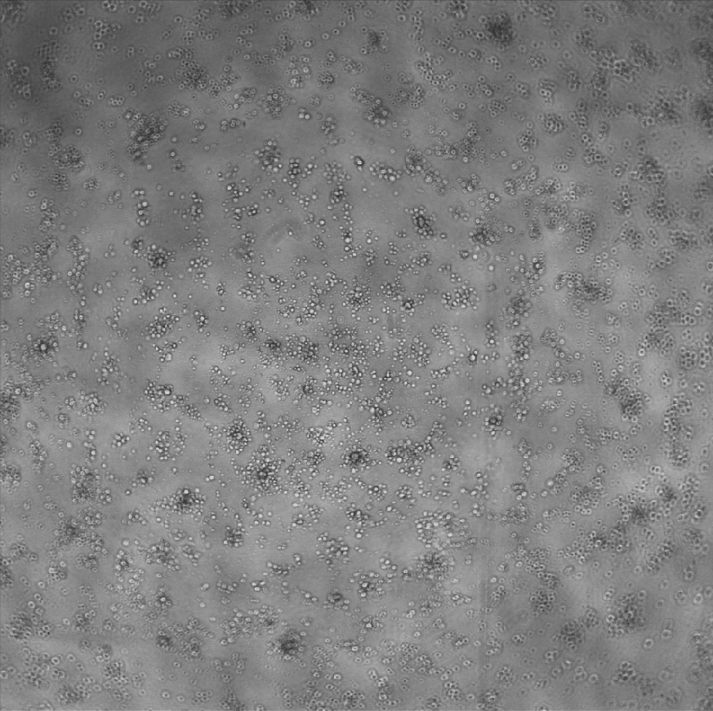
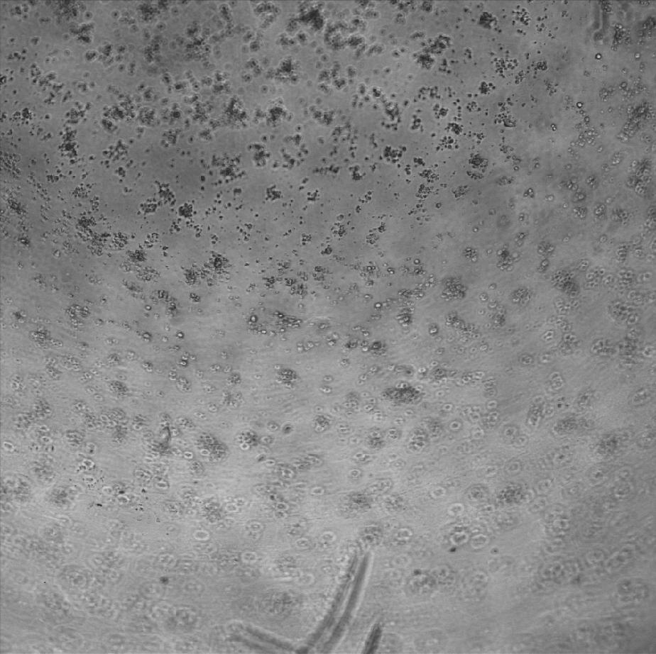
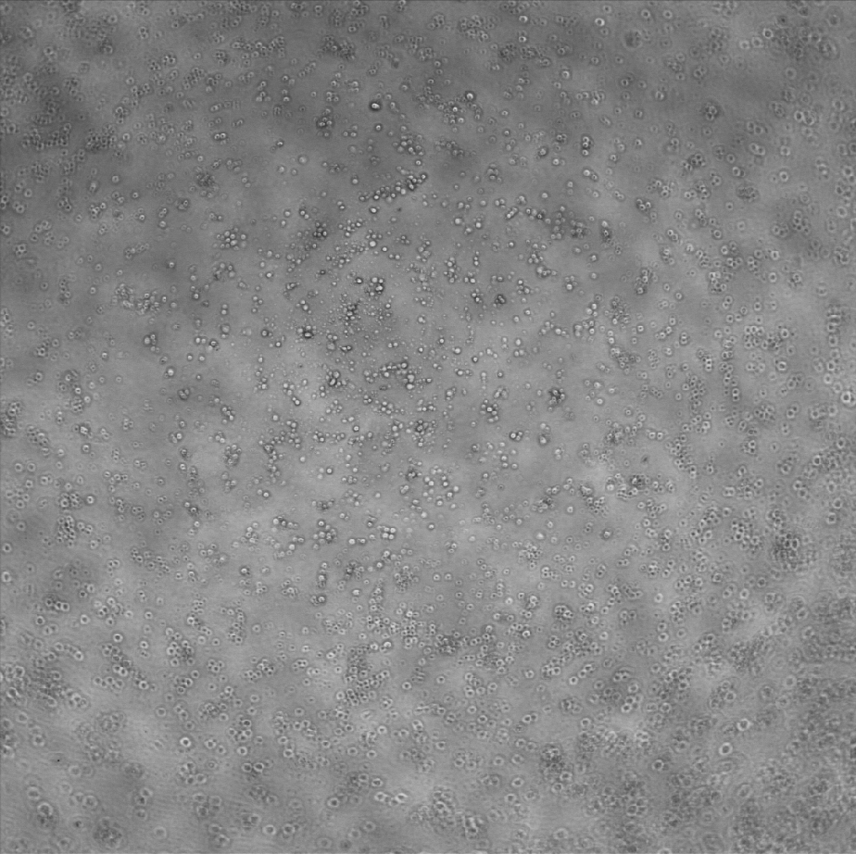
iPSC 2018.5.03
Control 20 hours after seeding
1
2
3
200 µm
200 µm
200 µm
4
5
6
200 µm
200 µm
200 µm
7
8
9
200 µm
200 µm
200 µm

Slide 7
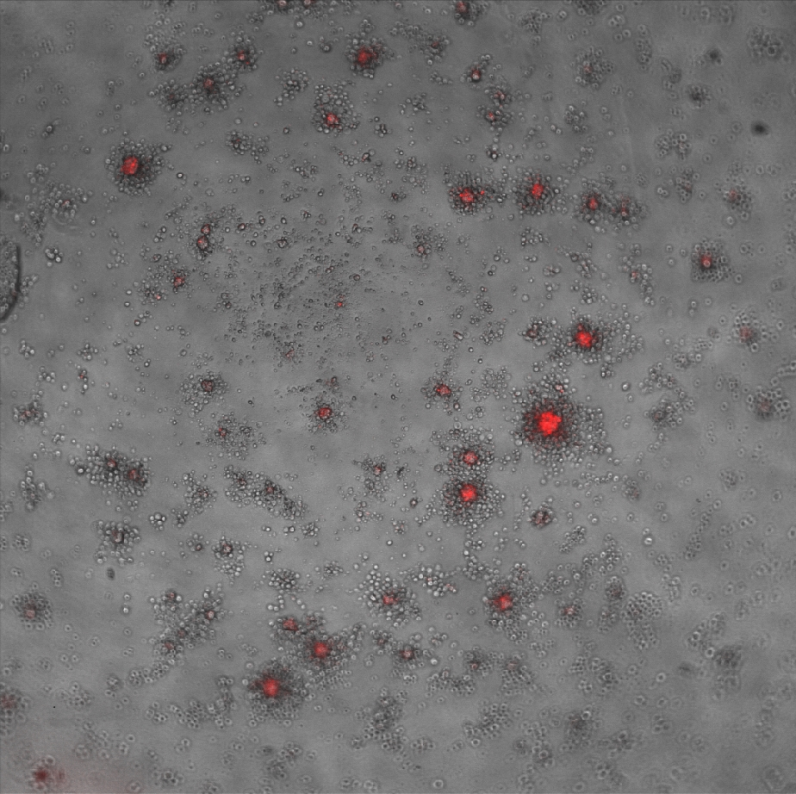
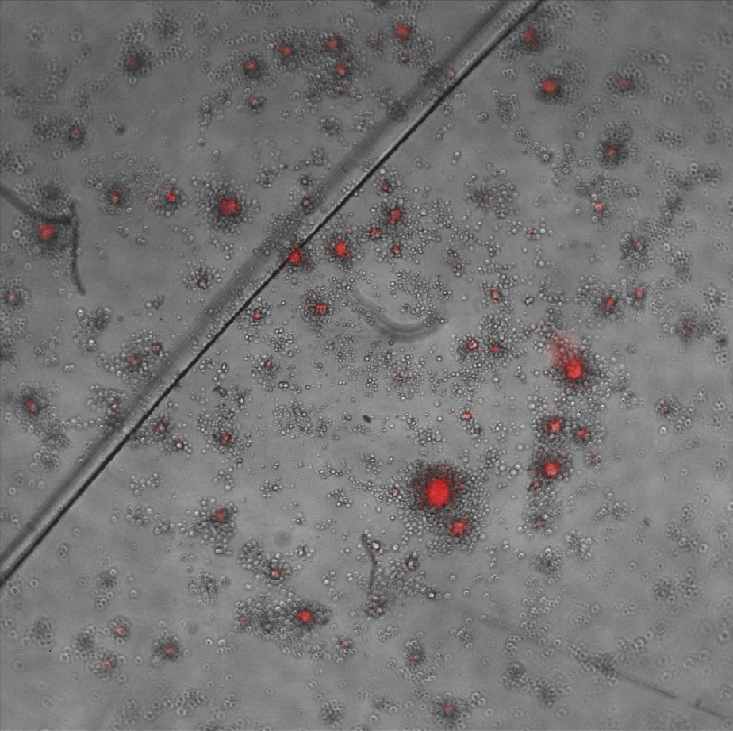
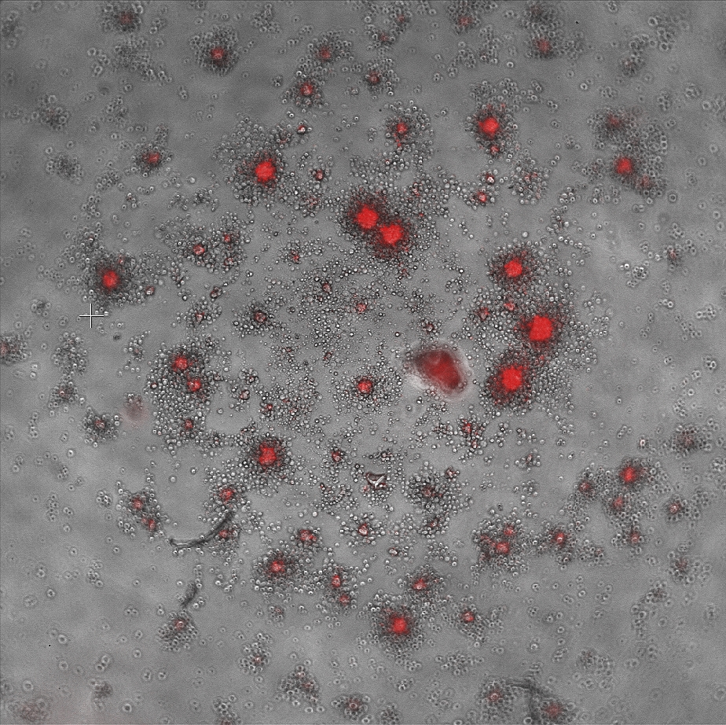
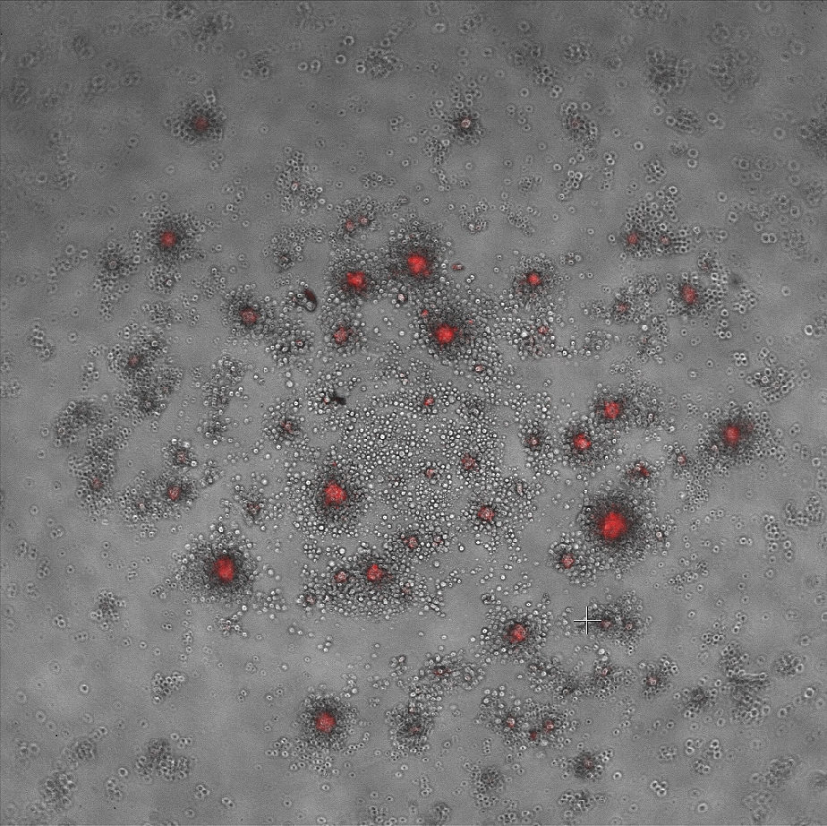
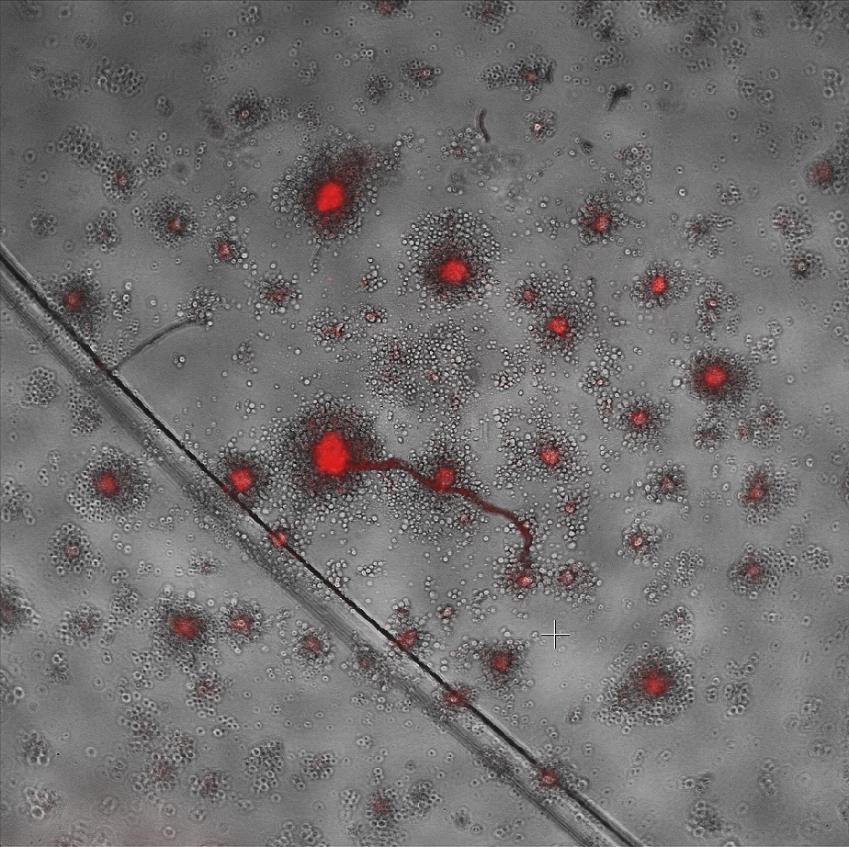

iPSC 2018.5.03
Cell/particle 18 hours after seeding
1
2
3
200 µm
200 µm
200 µm
4
5
6
200 µm
200 µm
200 µm

Slide 8








THP-1 staining 2018.5.03
A
B
A
B
50 µm
50 µm
50 µm
50 µm
C
D
C
D
50 µm
50 µm
50 µm
50 µm
A: P3HT
B: PAH(pH=10)/C18
C: PAH(pH=10)
D: BSA/C18
A: iPSC (2018.5.3)
B: Endo (2018.3.8)
C: hMSC (2018.2.28)
D: HeLa (2018.1.17)

Slide 9












a(0h)
a(24h)
a(63h)
a(90h)
200 µm
200 µm
200 µm
200 µm
b(0h)
b(24h)
b(63h)
b(90h)
200 µm
200 µm
200 µm
200 µm
c(0h)
c(24h)
c(63h)
c(90h)
200 µm
200 µm
200 µm
200 µm

Slide 10












d(0h)
d(24h)
d(63h)
d(90h)
200 µm
200 µm
200 µm
200 µm
e(0h)
e(24h)
e(63h)
e(90h)
200 µm
200 µm
200 µm
200 µm
f(0h)
f(24h)
f(63h)
f(90h)
200 µm
200 µm
200 µm
200 µm

Slide 11










Merging
0h
6h
22h
30h
48h
200 µm
200 µm
200 µm
200 µm
200 µm
56h
73h
80h
104h
126h
200 µm
200 µm
200 µm
200 µm
200 µm

Slide 12










0h
6h
22h
30h
48h
100 µm
100 µm
100 µm
100 µm
100 µm
56h
73h
80h
104h
126h
100 µm
100 µm
100 µm
100 µm
100 µm

Slide 13








10A
0h
24h
48h
74h
200 µm
200 µm
200 µm
200 µm
0h
24h
48h
74h
100 µm
100 µm
100 µm
100 µm

Slide 14








10B
0h
24h
48h
74h
200 µm
200 µm
200 µm
200 µm
0h
24h
48h
74h
100 µm
100 µm
100 µm
100 µm

Slide 15








10C
0h
24h
48h
74h
200 µm
200 µm
200 µm
200 µm
0h
24h
48h
74h
100 µm
100 µm
100 µm
100 µm

Slide 16








10D
0h
24h
48h
74h
200 µm
200 µm
200 µm
200 µm
0h
24h
48h
74h
100 µm
100 µm
100 µm
100 µm

Slide 17








10E
0h
24h
48h
74h
200 µm
200 µm
200 µm
200 µm
0h
24h
48h
74h
100 µm
100 µm
100 µm
100 µm

Slide 18








10F
0h
24h
48h
74h
200 µm
200 µm
200 µm
200 µm
0h
24h
48h
74h
100 µm
100 µm
100 µm
100 µm

Slide 19








10G
0h
24h
48h
74h
200 µm
200 µm
200 µm
200 µm
0h
24h
48h
74h
100 µm
100 µm
100 µm
100 µm

Slide 20




d = 7 µm
d = 5 µm
Center to center: 21 µm
Center to center: 10 µm
Pivot
- - - - - - - -
+ + + + + + + + + + + + +
2cm
Sublist 1
Sublist 2
A narrow glass slide
Fill it fully
1cm
0.6cm
Top View
Side View
Stamp
Stamp
A narrow glass slide
Gelatin film
Printed micro device
Glass
Live cell bind to device
PDMS
Depth determined by
PDMS film
37°C
Released cell/device complex
8°C
Glass
1: PDMS cover film
PDMS
4: Glass slide
3: Glass slide
2: Bottom PDMS film

Slide 21



+
Reaction 1
R_1 requires electron
−
Reaction 2
R_2 produces electron
Control:
Experiment 1:
Experiment 2:
: Cell Spheroid (20,000 cells)
: Cell/Particle Spheroid (20,000 cells)
: Larger Cell Spheroid (40,000 cells)

Slide 22
Head
Data
Member
Data
Member
Data
Member
Data
Member
nullptr
Head
Data
Member
Data
Member
Data
Member
Data
Member
nullptr
nullptr
Head
Data
Member
Data
Member
Data
Member
Data
Member
Top
Stack
Member
Stack
Member
Stack
Member
Stack
Member
nullptr
New
Member

Slide 23
null
M
F
T
C
I
P
W
B
E
H
K
O
R
V
Y
A
null
D
null
G
null
J
L
N
null
Q
S
U
null
X
Z
null
null
null
null
null
null
null
null
null
null
null
null
null
null
null
null
null
null
null
null
null
null
Data
Member
P
P

Slide 24
Decision
Terminal
Begin
Start
End
Allocate a new node using the data given
Input / Output
Operations
Connector
Decision
Yes
Is list empty?
No
Process
Make head point to the new_node
Traverse the list to find the last node
Decision
Make new_node->next point to nullptr
Make last_node->next point to new_node
Make new_node->next point to nullptr
Switch()
End
Case 1
Case 2
Case 3
Case 4
Case 5

